Slide 1

Replication of Research paper entitled “Molecular markers of early Parkinson’s disease based on gene expression in blood”
PREPARED BY
Rashmita Vaggu
Meher Nivedita Avdut
Muttaki I. Bismoy
PREPARED FOR
Dr. Suhila Sawesi, Ph.D., MPharm, BPharm

Slide 2

Motivation
The project carried out a replication of the seminal study by Scherzer et al. (2007), which identified molecular markers of early Parkinson's disease (PD) through gene expression analysis in blood. Parkinson’s disease (PD), a neurodegenerative disorder affecting millions of people, lacks definitive laboratory tests for early detection. Our analysis concentrated on 53 out of the original 105 genes, utilizing a subset of the original dataset as a result of computational constraints. In order to ascertain genetic expression differences between individuals with Parkinson's disease (PD) and healthy controls, we utilized Python to conduct t-tests. For multiple testing corrections, we implemented the Benjamini-Hochberg procedure. Our replication, notwithstanding these limitations, yielded significant insights into the patterns of gene expression during the early stages of Parkinson's disease. The significance of the project lies in its potential to enhance molecular comprehension of Parkinson's disease, thereby providing opportunities for early detection and intervention.

Slide 3

01 Background
04
Analysis
02 Formulation Process
05
Results & Discussion
TABLE OF CONTENTS
03 Model Description
06
Conclusion
How we replicated the paper
Our replication approach
Comparing and sharing our outcomes
Steps we followed
Which models we replicated
Coming to end and stating the learning

Slide 4

Background
In order to ascertain variations in expression, T-tests were performed, incorporating multiple testing corrections to guarantee reliability. Some inconsistencies were identified when our findings were compared to those of the original study, which were probably the result of divergent analytical methodologies.
The Need for Molecular Markers in PD
Methodological Overview of Scherzer et al.’s Study
Approach and Limitations
Statistical Analysis
Comparisons and Insights
Heatmap Analysis

Slide 5

Formulation process
The project aimed to replicate important facets of the groundbreaking study by Scherzer et al. (2007), "Molecular markers of early Parkinson's disease based on gene expression in blood." The main goal was to find a group of genes whose expression levels are significantly different between people with early stage Parkinson's disease (PD) and healthy control subjects. This would help find possible molecular markers for early PD.
Objective Definition
Gene Expression Analysis
Statistical Evaluation
Data Visualization Techniques

Slide 6

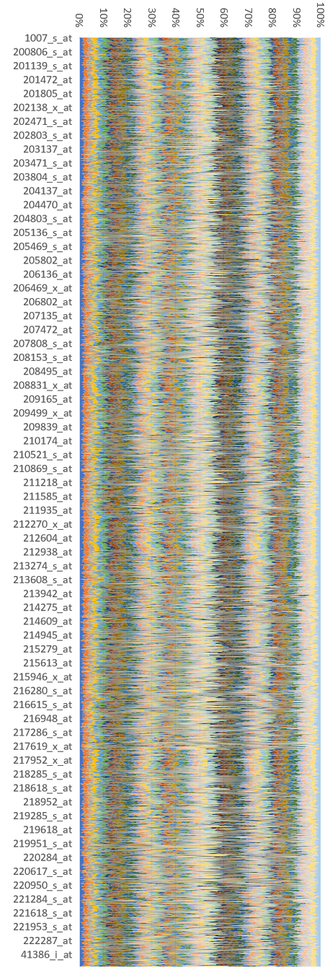
Model Description
Heatmap

